Slide 1



Publishing an App on
Google Play Store

Slide 2
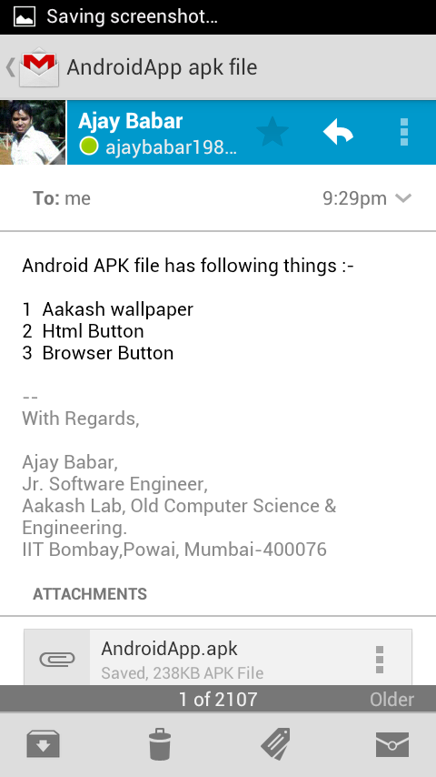

Different Ways of
Distributing an App
Through an Application Marketplace.
Through E-mail.
Through a website

Slide 3
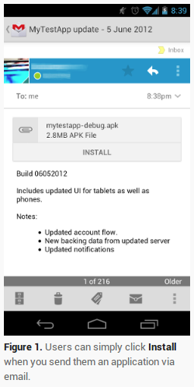
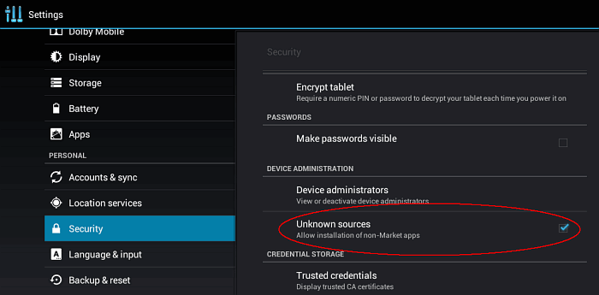
Snapshot for Unknown Sources
Through an App Marketplace
Through E-mail
Through a web site

Slide 4
Steps of publish an App on Google Play
1. Go to play.google.com/apps/publish/
2. Upload an Application
1. Upload .apk file
2. Upload icons/images of an Application.
3. Listing Details
1. Language – English, Title, Description
2. Category – Entertainment / Education /Business/...
3. Price – free / priced.
4. Publishing options
1. Set copy protection to on / off
2. set Content rating to All
3. set Location to All location
5. Contact Information
1. website name, E-mail, phone number
6. Check for acknowledge and click on Publish button.

Slide 5
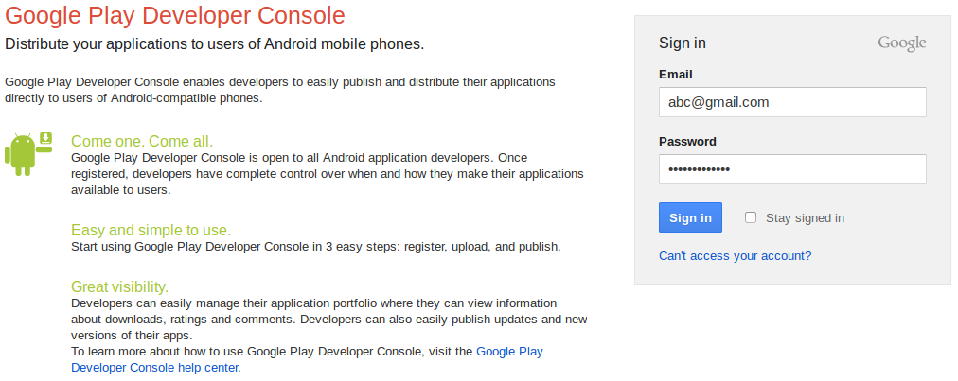
Sign in for Google Play
http://play.googl.com/apps/publish/

Slide 6
References
1. developer.android.com
2. play.google.com

